Slide 1
SOGAZ INSURANCE
INTERNATIONAL COOPERATION:
NEW HORIZONS
Dmitry Talaev
Executive Director -
Member of the Board
SOGAZ INSURANCE
Asia-Pacific Risk and Insurance Association, APRIA conference
Moscow, 29th July 2014

Slide 2
The Global market overview Current trends
Economic environment is changing rapidly:
- ways of doing business and new technologies reshape the whole industries;
- globalization requires more resources and brings new opportunities as well as new risks;
- drivers of world economy shift to emerging markets from Asian and Latin America regions, developing countries gain more influence;
Role of insurance also became critically important for steady growth of national economies.
Insurance business is international by its nature. As complexity and value of the risks have been increased dramatically for latest 50 years, most of this business has to be spread between many companies from different countries all over the World.
“World reinsurance market” – has became generally accepted conception recently.

Slide 3
The Global market overview
World picture – primary insurance
Regional distribution of total primary insurance premium, %
Reference source: Swiss Re

Slide 4
The Global market overview
World picture - reinsurance
Regional distribution of total reinsurance premium, in %
Reference source: Swiss Re

Slide 5
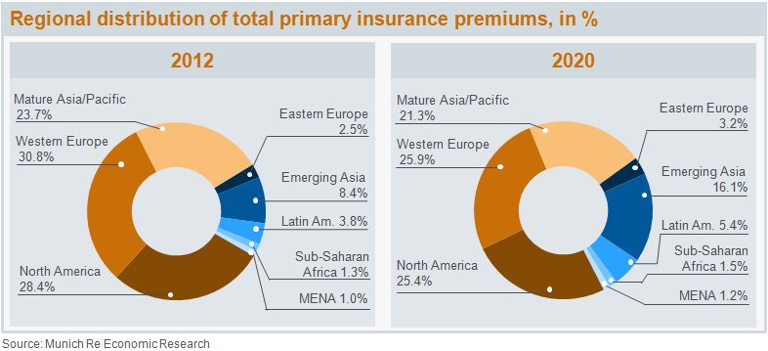
The Global Market overview Long-term forecast up to 2020
According to analysts of specialized reinsurance companies and rating agencies the proportion of total primary insurance premiums coming from “mature” markets will fall from 83% in 2012 to roughly 73% in 2020. 'Emerging Asia' countries, on the other hand, will double their market share from 8% to 16%.
Similar changes are expected in reinsurance, although the proportion of reinsurance business attributable to industrialized countries is already lower than in primary insurance, be-cause of the tendency for emerging markets to have a stronger need for reinsurance cover.
Today most of the leading reinsurers declare their special interest for emerging markets and correct their long-term strategies to gain the opportunities.

Slide 6
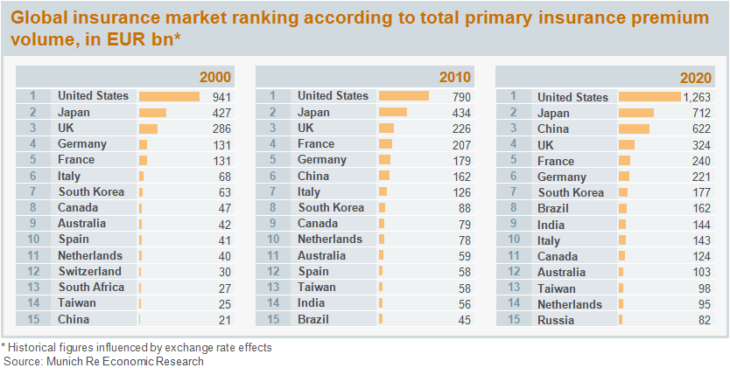
The Global Market overview Long-term forecast up to 2020
Accordingly, the global rankings of the largest primary insurance markets will change over time. While China was only in 15th place in 2000 in terms of total premium income, for example, in 2010 it had already reached 6th place – and in 2020 is likely to be at number three. Brazil and India will also be in the top ten in 2020. However, the dominant position of the US market, followed by Japan, is unlikely to change by the end of the decade.

Slide 7
World Reinsurance market – new opportunities
We have evolving marketplace that reflects recent shifts in Global economy and which is mainly unexploited.
There is a huge potential for reinsurance business between companies from emerging markets which is in line with current economical and political movements between our countries.
Closer cooperation in short-term perspective will benefit in:
Strengthening financial capabilities and increase capitalization of national insurers;
Reducing dependence upon traditional providers of reinsurance capacity and thus offer more competitive pricing
Easing monopoly of Lloyd’s in some classes of business (offshore construction, marine, aviation).
In long-term perspective development of the new markets would lead to creation of new financial and reinsurance “hubs” - alternative to traditional centers as London and New York.

Slide 8
World Reinsurance market – new opportunities
As a practical implementation:
Close cooperation of national insurers and reinsures on strategic projects realized by our countries in partnership (esp. when State financing is involved);
Reinsurance support of each other for domestic business in developing countries - exchanging shares in reinsurance programs;
Creation of specialized reinsurance arrangements (pooling agreements, mutual, etc.) for high-valued, complexed risks in Energy sector and other.

Slide 9
World Reinsurance market – new opportunities
Existing difficulties:
National insurance markets are too different from each other – that makes efficient cooperation difficult task;
Lack of expertise in some areas of business, poor data and information on risks and hazards;
Legislative and administrative barriers – restrictions on international operations and prevalence of the rating.
Nevertheless!
Insurance sector in developing countries is highly attractive and is likely to keep it for the next decade.
To exploit its potential joint efforts are required by all interested parties – insurance companies, government entities, international organizations and associations.

Slide 10
© 2014 SOGAZ
In the presentation dates and analytical materials of S&P, Fitch, Munich Re, Swiss Re, Source, IAIS, GIMAR, Expert RA being used.

