Slide 1
Economic Development and Insurance Regulation of Korea (Republic of)
July 28, 2014
Hongjoo JUNG
(SKK University, Seoul, Korea)
‘The Host Institution of 2012 APRIA’

Slide 2
Contents
1. Theme of this Presentation
2. History of Economic growth and Fiancial (insurance) Regulation of Korea
3. Self-Regulation in Korea
4. Summary

Slide 3
1. Theme of this Presentation
A Case Study of
how the (North East) Asian culture
shapes Insurance Regulation
with respect to Economic Development
(in pecking order of public interests)
A Strategic growth model?
(or Model of a big brother in poor family)

Slide 5
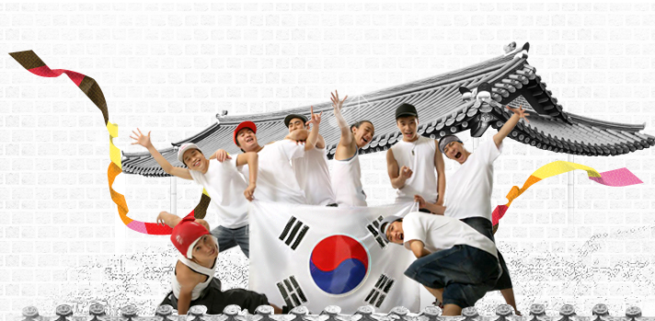
Korean Economy Today
Population : 50 Million (24th in the world)
Per capita GDP : 30,000 $ (42nd …)
Total Size of Economy (12th in the world)

Slide 6
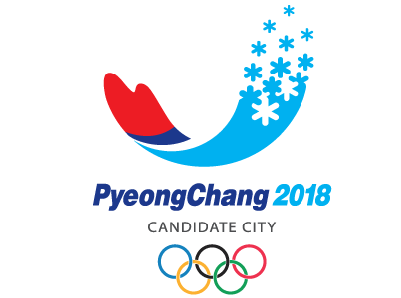
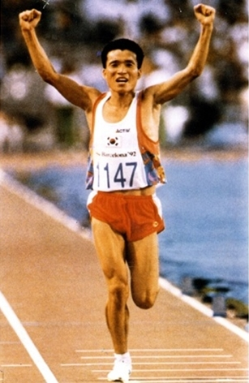
ECONOMIC MIRACLE BASED ON HUMAN RESOURCE DEVELOPMENT
THE NUMBER OF FOREIGN STUDENTS IN USA (AS OF 2010)
INDIA 100,000
CHINA 98,000
KOREA 75,000 *****
CANADA 30,000
JAPAN 30,000
……

Slide 7
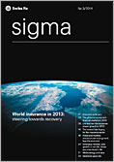
Overview of
Korean Insurance Market
(from Sigma, 3/2014)
Density of the year 2013
- ranked No.20 in the world
- 2,895$ (=1,816$ + 1,079$)
total premium pp = LI + NLI
Penetration of the year 2013
- ranked No.5th in the world
- 11.9% = 7.5%+4.4%)
total ratio pp = LI + NLI

Slide 8
2. History of Economic Development & Financial (Insurance) Regulation of Korea

Slide 9
Brief Review of past 5 decades
 | Real Economy | Financial Services Sector | Insurance Regulation
1960’s | Beginning of Economic growth | Interest rates below market level | Just Entry regulation
1970’s | Continuing Growth | Life insurance growth | Market conduct regulation begins
1980’s | Culmination of Economic growth rate | Financial Markets opened to foreigners | Minimal Solvency Regulation
1990’s | Asian Financial Crisis | Many Failures and Sales to Foreigners | Solvency Margin by Integrated FSA
2000’s | IT Bubble and U.S. based financial crisis | Restructuring and Restoration | Risk Based Capital Regulation started
2010’s | Lowered growth rate & European Fin. crisis | Consumerism strengthened | Market Conduct Supervision

Slide 10
Korean Economic Growth
Depended upon
Foreign Trade & Manufacturing,
Which, in turn, relied upon
Financial Services Sector
(Financial Consumers)

Slide 11
Insurance Regulatory Policy for Economic growth
Life Insurance Sector
High price policy
Mass-sales policy
For capital accumulation for economic growth
Without necessary supervision
Justified by continuing volume growth
Non-Life Sector
Automobile insurance: price control (against inflation & auto-industry growth)
Other General insurance : high price policy (for cross- subsidization

Slide 12
Existing Pecking Order of Regulatory Goals
General Political Agenda
Economic Growth Policy
Prior Goal of Financial Supervision
Prudential Regulation
Secondary Goal of Financial Supervision
Market Conduct Regulation
Residual goal of F.S.
Self-Regulation

Slide 13
A few Financial Scandals in 2000’s
Credit Card Indebtedness
Saving & Loan Failures
KIKO Scandal
….

Slide 14
Two Recent Request for a new financial Regulatory Regime
Separation of General Growth policy from Financial Supervision (toward an independent financial supervision)
Separation of Prudential Supervision from Market Conduct Supervision (toward a so-called twin-peak system)

Slide 15
Consumers’ Initiative expecting a new Regulatory Structure
Weakening Dominance of E.G.P.
over Financial Regulation
Economic Growth Policy
Separation of P.R from M.C.R
Prudential Regulation
Growth of M.C. Regulation
Market Conduct Regulation
.
Either mutual growth
or reduction by replacement
of M.C.R.
Self-Regulation

Slide 16
3. How about Self-Regulation in Korea?

Slide 17
Meaning of Self-Regulation
Regulation executed by the ‘Regulated’,
Through an Organization delegated by the ‘Regulated’,
In order to supplement or prevent from normal regulation,
Legally based upon agreement among the regulated, delegation of a public regulator, or direct mandate of a law

Slide 18
Typology of Insurance Regulation
 | Public Regulation | Self-Regulation
Prudential Regulation | X → O → OO | X
Market Conduct Regulation | O → X → O | X → O → O
System (Protection) Regulation | O | X
Scope of Self-Regulation in Korea
(1) Administration with Distribution channels
(2) Affairs associated with Market Competition
(3) Information disclosure

Slide 19
Scope of Self-Regulation in Korea (1) Administration with Distribution channels
Registration of Salespersons
(including agents and solicitors)
- Qualification test of salespersons for Variable life policies

Slide 20
Scope of Self-Regulation in Korea (2) Affairs associated with Market Competition
Awarding exclusive sales right of any new insurance products to their developer
- Agreement for keeping Fair competition
(Review and sanction of any unfair practice of sales)
- Control of newly developing gigantic Independent Agencies (GA in Korean)

Slide 21
Scope of Self-Regulation in Korea (3) Information Disclosure
Setting a Standard for Corporate Disclosure
Comparative Disclosure of company wide products
Exchange of contract information

Slide 22
Special Characteristics of SR in Korea
Executed by the insurance associations,
(1) dominated by a few major members,
(2) in group-oriented & vertical culture,
(3) with several foreign members,
(4) represented by chairperson (≠ a company’s incumbent CEO) appointed by the Regulator
* KLIA (Korea Life Insurance Association),
KGIA (Korea General Insurance Association),
KFPA (Korea Fire Protection Association)

Slide 23
Evaluation of SR in Korea
 | PROs | CONs
Legitimacy | - Motivate internal control | - Need more legal supports
Effectiveness | - Reduce official regulation | - Many consumer complaints
Efficiency | - Conduct many micro issues
Fairness |  | - Bias toward major insurers

Slide 24
Future of SR in Korea
Scope of Self-Regulation in Korea
Administration with Distribution channels
Affairs associated with Market Competition
(including Financial Consumer Protection)
Information disclosure → going to normal regulator
Regulation executed by the ‘Regulated’,
Through an Organization delegated by the ‘Regulated’,
In order to supplement or prevent from normal regulation,
Legally based upon agreement among the regulated, delegation of a public regulator, or direct mandate of a law

Slide 25
4. Summary
Korean insurance regulation has been dominated by higher goals of economic growth or stability (vertical system).
But, it is now moving into a consumer oriented (horizontal) system.
Self-Regulation appears to complement official supervision, in a partial success.
How do you like this Model ?

Slide 26
Спасибо !
Thank you!

