Slide 1
Insurance and the New Economy
Prof. Yehuda Kahane
Tel Aviv University (Emeritus)
COB Reboot & Prosperity Center
kahane@ykcenter.org
APRIA Moscow July 2014

Slide 2
The Invisible hand Capitalism M.C. Escher

Slide 3
The Post Industrial Economy
Continuous, accelerating (exponential) change processes
New production Factor – Data & knowledge
Population, urbanization, consumption
Age pyramids and life expectancy
Labor market and retirement
Education
The basic economic unit

Slide 4
where does the invisible hand takes us to?

Slide 5
Black swans
כל הזכויות שמורות

Slide 6
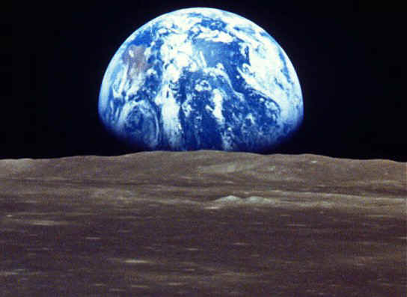
ESEC
There is a need for a paradigm shift

Slide 7
We shall reach the targets we aim to A new Dashboard
OECD
Well-Being Indicators

Slide 8
Insurance in the New Economy
Importance of insurance in the rich economies
Insurance growth exceeds national growth
Insurance and Banking

Slide 9
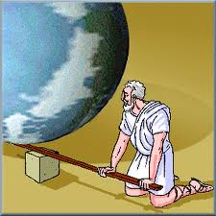
Archimedes

Slide 10
Insurance – the key for change
Food Production
Terror and war risks
Mitigation of environmental effects
Monetary systems
Insurers are related to the risks and also in long term investments

Slide 11
RIO+20

Slide 12
“You don’t drown by falling into the water, but by staying too long under the water “ Edwin Louis Cole

Slide 13
YES
WE
CAN!

Slide 15
Thank you!
Prof. Yehuda Kahane
kahane@ykcenter.org

